Slide 1
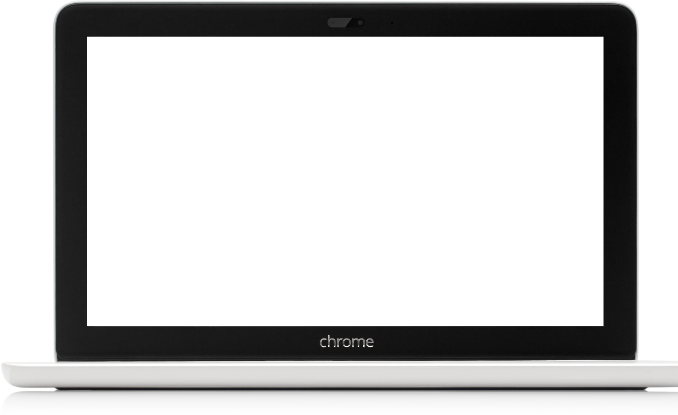
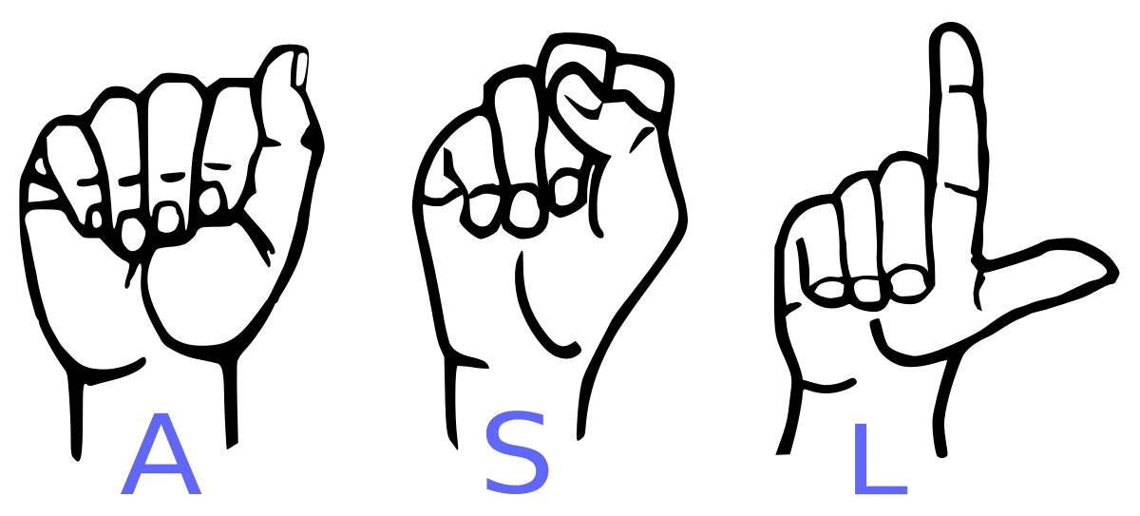
Sign Language Recognition
- Kunal Maggo(01611503018)
- Samyak Jain(02511503018) - Mayank Negi(01711503018)

Slide 2
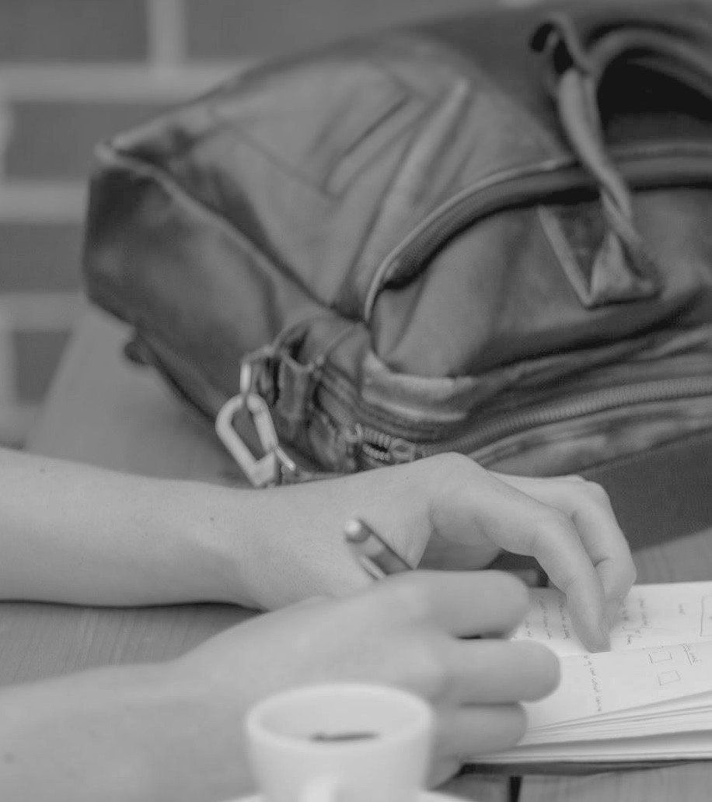
Research Problem
Speech impaired people use hand signs and gestures to speak. Regular people face difficulty in understanding sign language. Hence there's a necessity of a system which recognizes the various signs, gestures and conveys the data to the conventional people. It bridges the gap between physically challenged people and regular people.

Slide 3
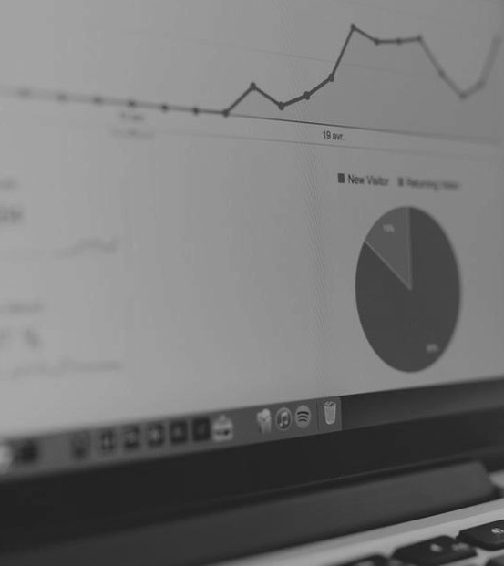
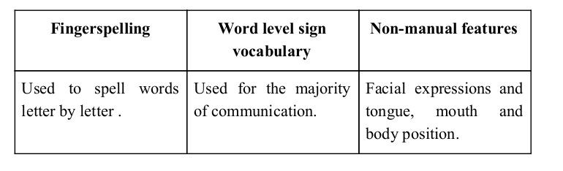
Sign language is a visual language and consists of 3 major components:

Slide 4
Our Solution
Our solution to this problem is to create a machine learning model to recognize Word Level Sign Language and to create an application which assembles the recognized Gestures which can also be converted to Audio and be translated for natives to understand.

Slide 5
Methodology

Slide 6
How we generated data set and labelled it ?

Slide 7
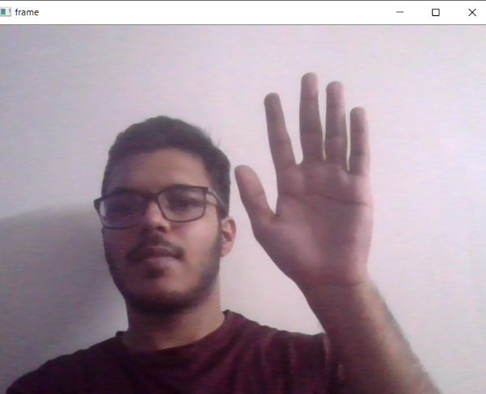
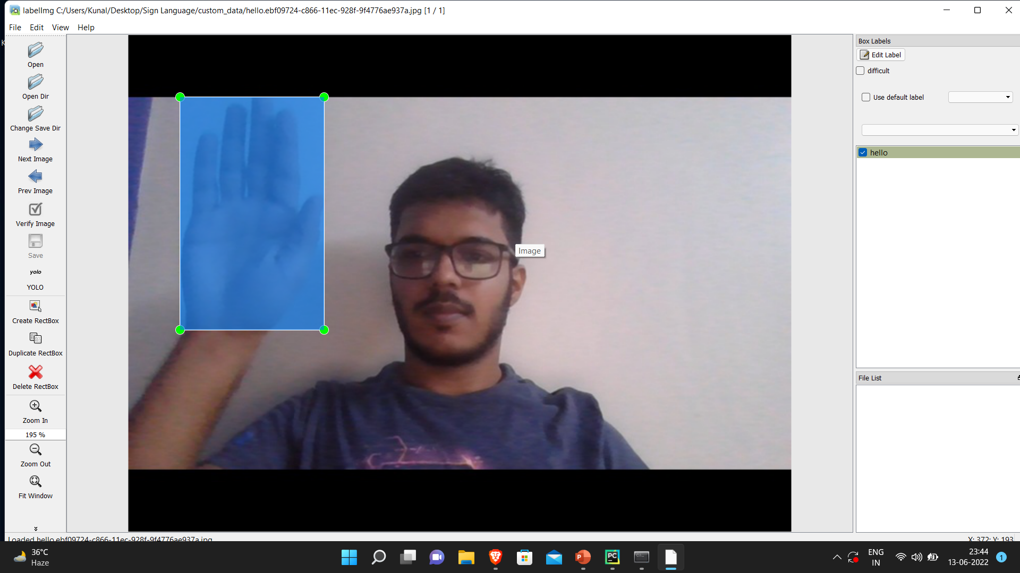
Capturing Raw Image
Labelling using Labelimg

Slide 8
Why we Created our own Dataset ?

Slide 9
➔ For the project we tried to find already made datasets but we couldn’t find dataset in the form of raw images that matched our requirements.
➔ Also to train the model we had to label images individually.
➔ Hence we decided to create our own data set.

Slide 10
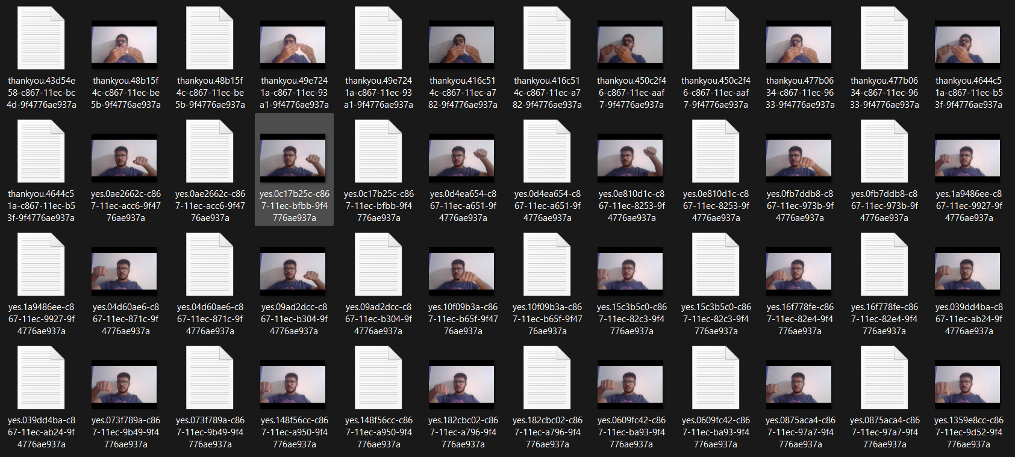
DATASET

Slide 11
Implementation

Slide 12
Technology Used –
Yolo Object Detection Algorithm
Darknet Neural Network Framework
OpenCV
Tkinter
Platforms Used –
Colab
PyCharm

Slide 13
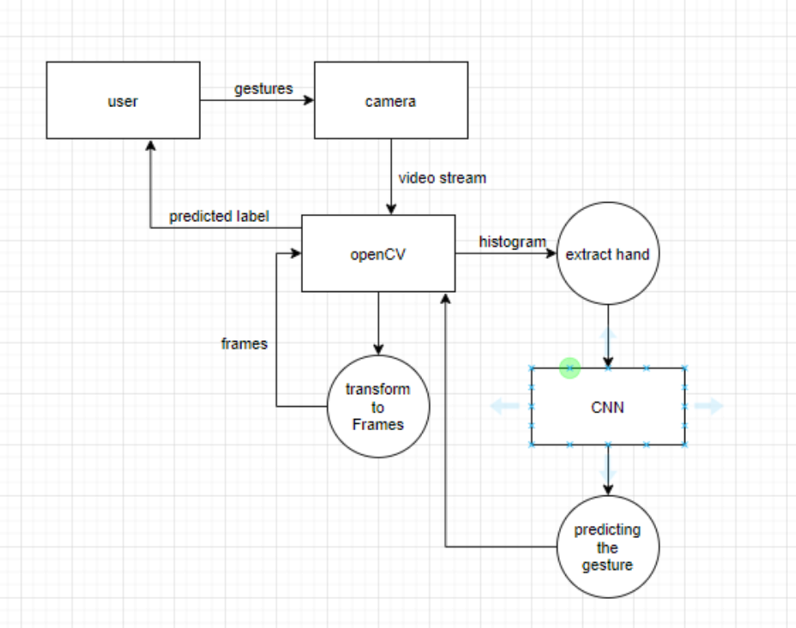
Flow Chart

Slide 14
Our CNN Classifier Model

Slide 15
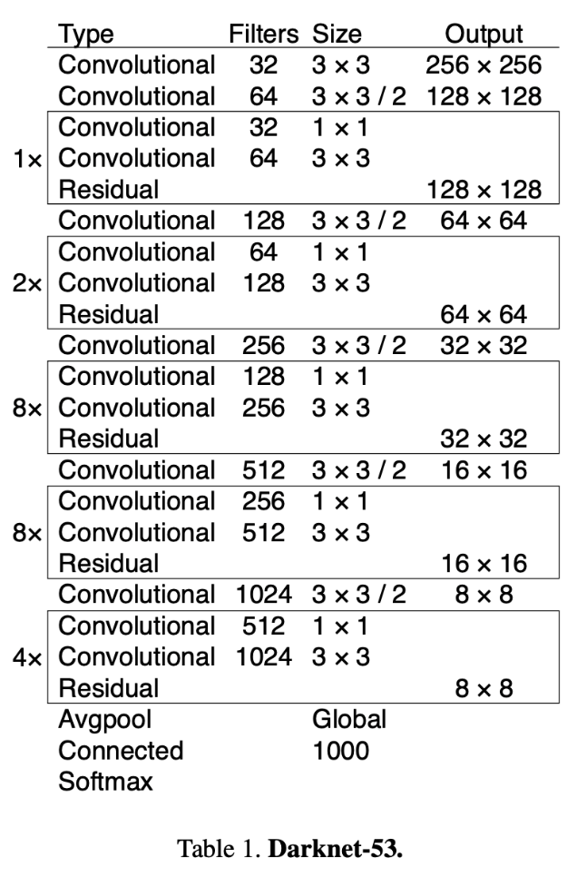
Darknet-53
Learning Rate – 0.001
Activation – Leaky Relu

Slide 16
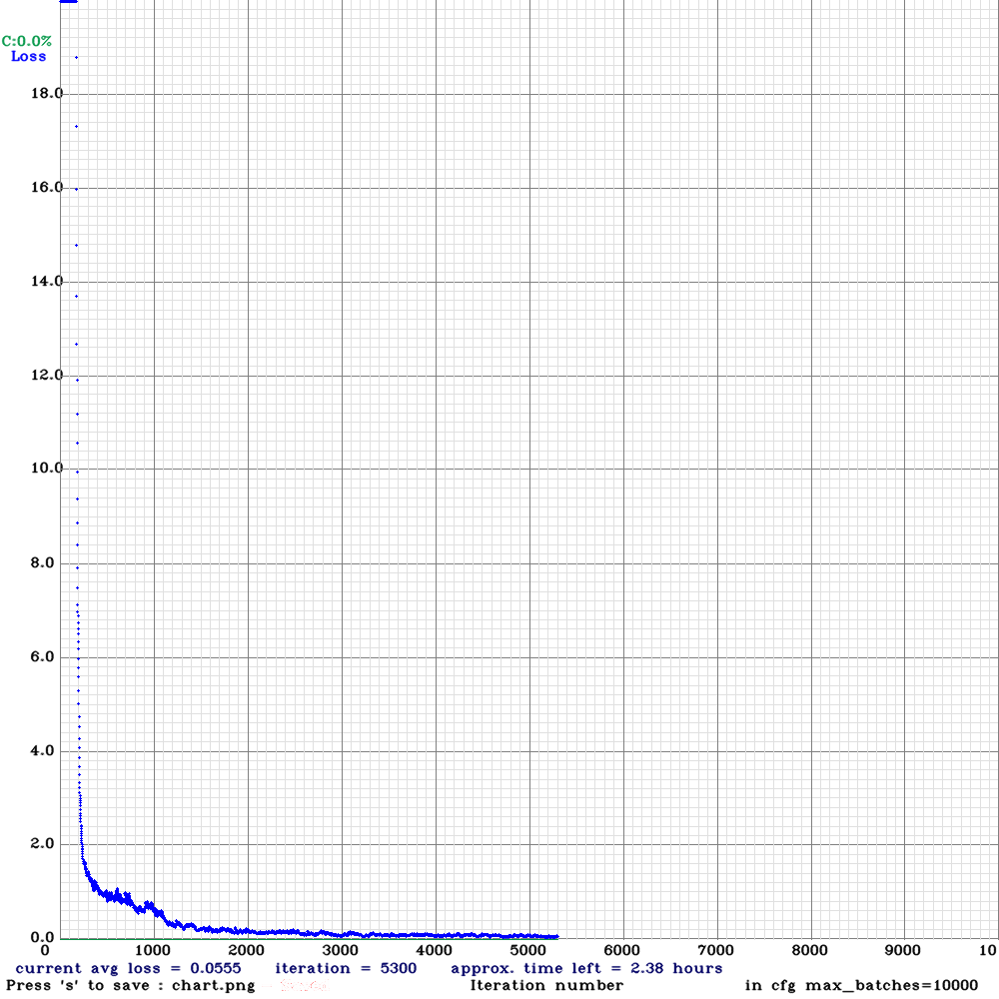
RESULTS
Average Loss – 0.0555

Slide 17
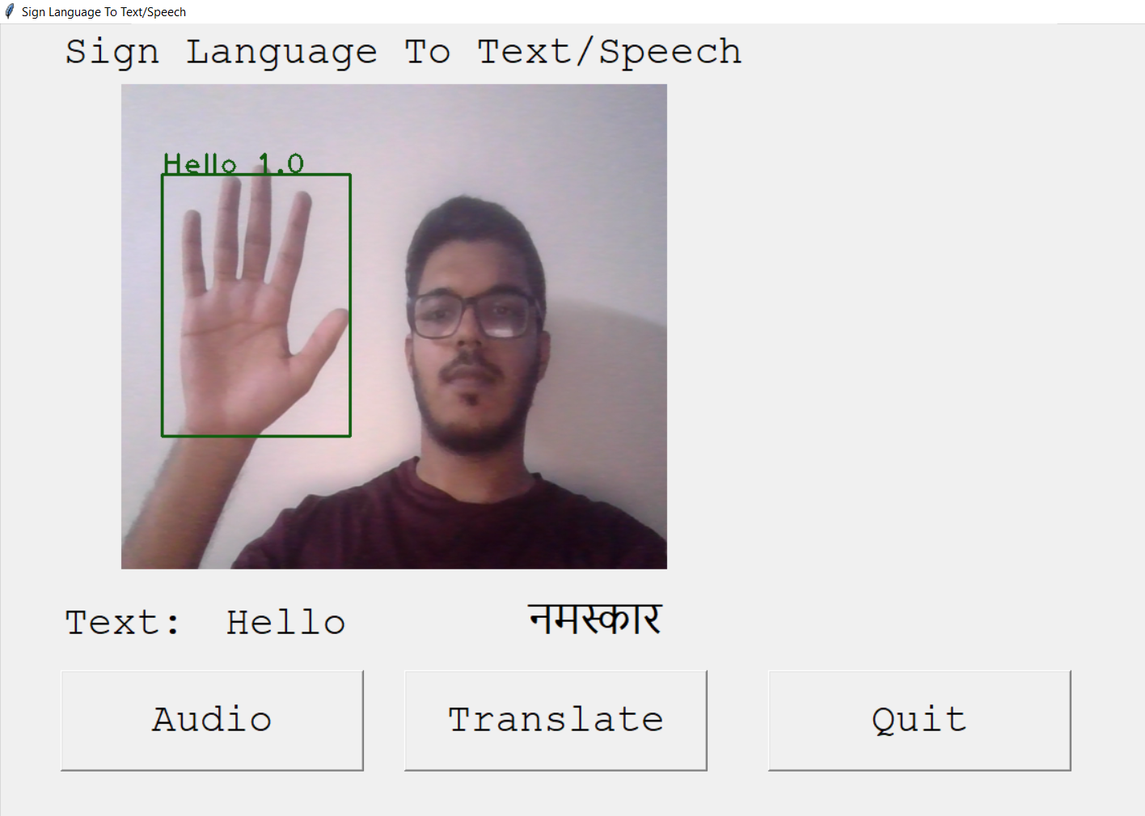
APPLICATION

Slide 18
Future Scope
Add more gestures to increase the flexibility of our Application.
We are also thinking of improving the preprocessing to predict gestures in low light conditions with a higher accuracy.

Slide 19
Thank You !

